Slide 1


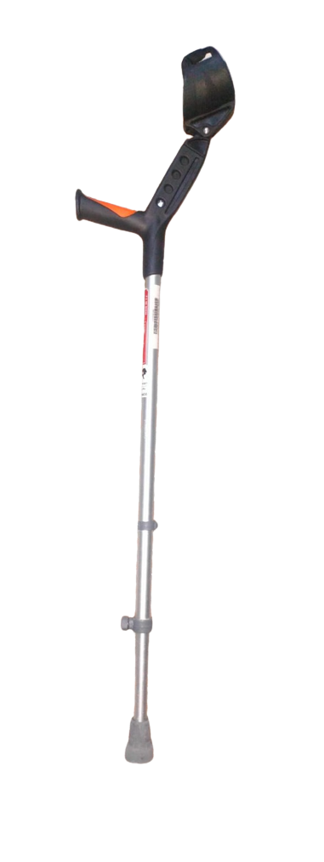








ELBOW CLUTCH
Doctor's Choice
Friend for Comfort

Slide 2
Appeal Used:
Emotional: Showcasing an older person smiling while using the crutch builds trust, confidence, and a sense of independence.
Rational: Product design (elbow support, lightweight, medical-grade) appeals to functionality and health benefits.

Slide 3
Target Audience Chosen:
Elderly individuals
Post-surgery patients (e.g., leg fractures)
People with mobility challenges
Caregivers or family members making purchase decisions

Slide 4
Preferred Media Channel:
TV advertisements on health/lifestyle channels.
YouTube ads targeting medical or senior health videos.
Hospital waiting areas/clinics digital signage.
Print ads in health magazines or pharmacy leaflets
Social media (Facebook, WhatsApp) for caregivers & older audience.

Slide 5
Thank You!

